Slide 1
Choosing the right model

Slide 2
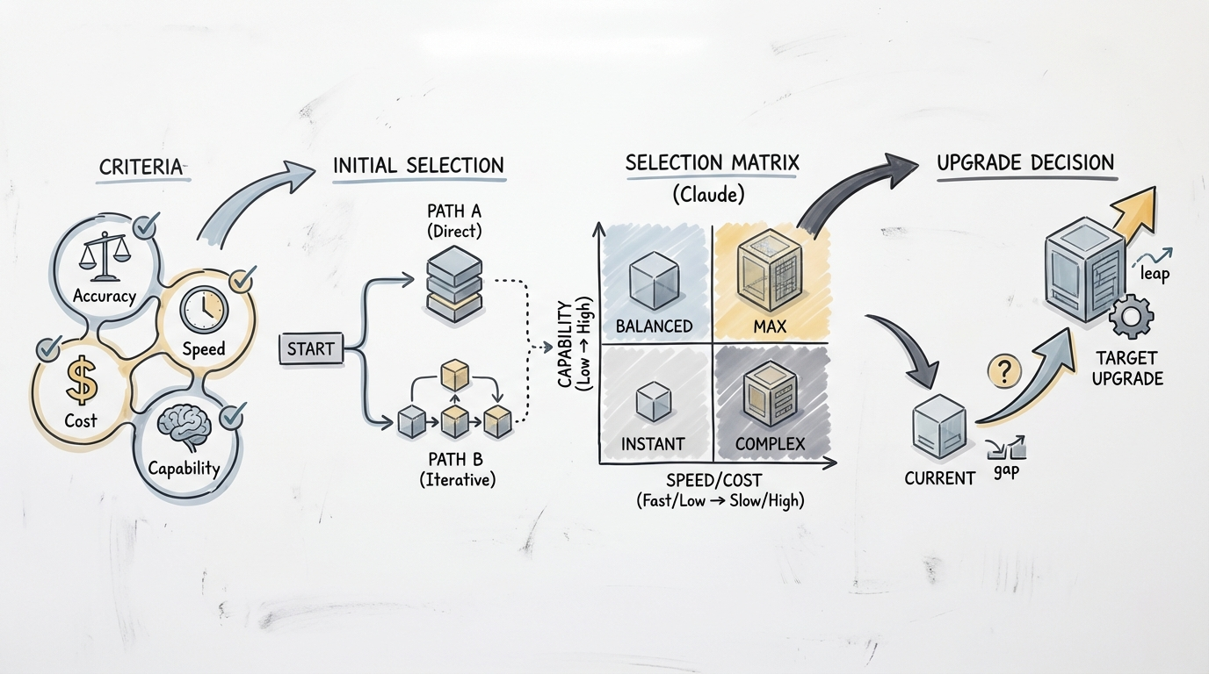
Choosing the right model

Slide 3
Agenda
✓ Introduction
★ Establish Key Selection Criteria
◆ Approaches to Initial Model Selection
➜ Claude Model Selection Matrix
● Decide on Model Upgrades
■ Key Takeaways

Slide 4
Introduction
✓ Balance model capabilities with speed and cost.
★ Choose optimal Claude model for your application.
◆ Guide structured decision-making based on requirements.
Notes:
This presentation outlines a structured approach to selecting the right Claude model. We'll focus on balancing key factors like capabilities, speed, and cost to meet specific application needs.

Slide 5
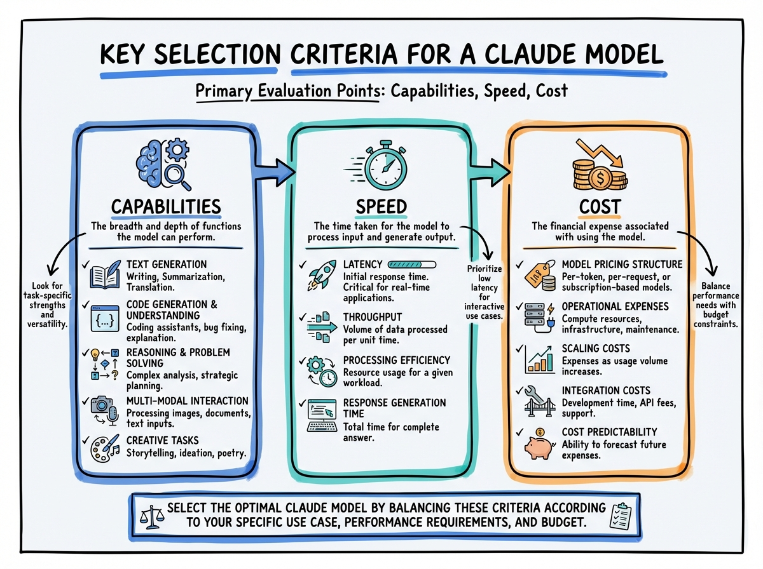
Establish Key Selection Criteria
Infographic for Establish Key Selection Criteria

Slide 6
Establish Key Selection Criteria
✓ Define precise model capabilities for application needs.
★ Determine required response speed and processing latency.
◆ Establish clear financial constraints and cost per token.
Notes:
Before selecting a Claude model, clearly define your core criteria. These factors will guide your evaluation and ensure the model aligns with your application's operational demands and budget.

Slide 7
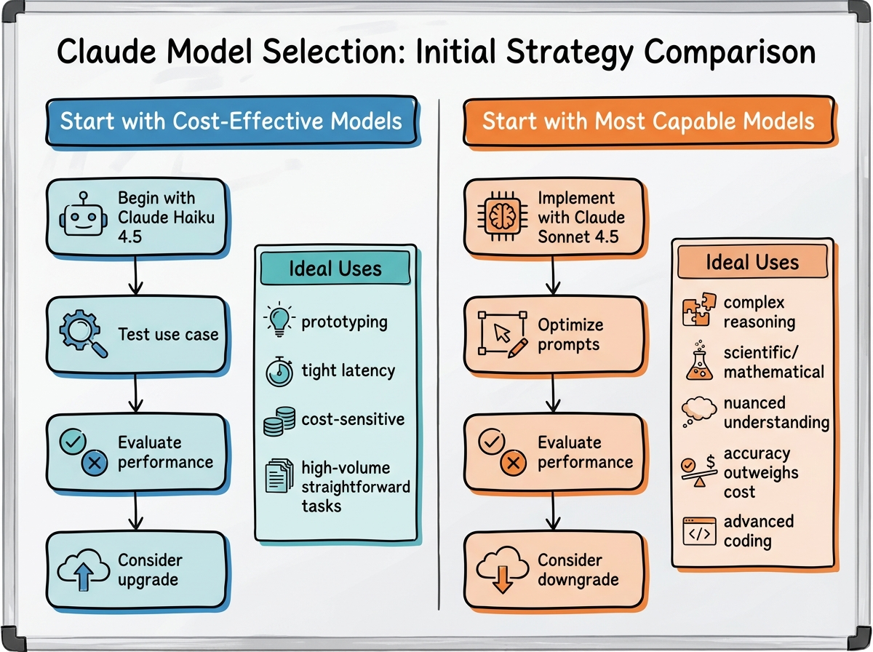
Approaches to Initial Model Selection
Infographic for Approaches to Initial Model Selection

Slide 8
Approaches to Initial Model Selection
✓ Begin with cost-effective models, e.g., Claude Haiku 4.5.
★ Prioritize rapid iteration and economical development.
◆ Test thoroughly for suitability and initial performance.
➜ Upgrade only if specific capability gaps arise.
Notes:
There are two main strategies for initial model selection. One involves starting with a cost-effective model like Claude Haiku 4.5 to quickly prototype and test basic functionality. This approach is ideal for many common applications and helps manage development costs.

Slide 9
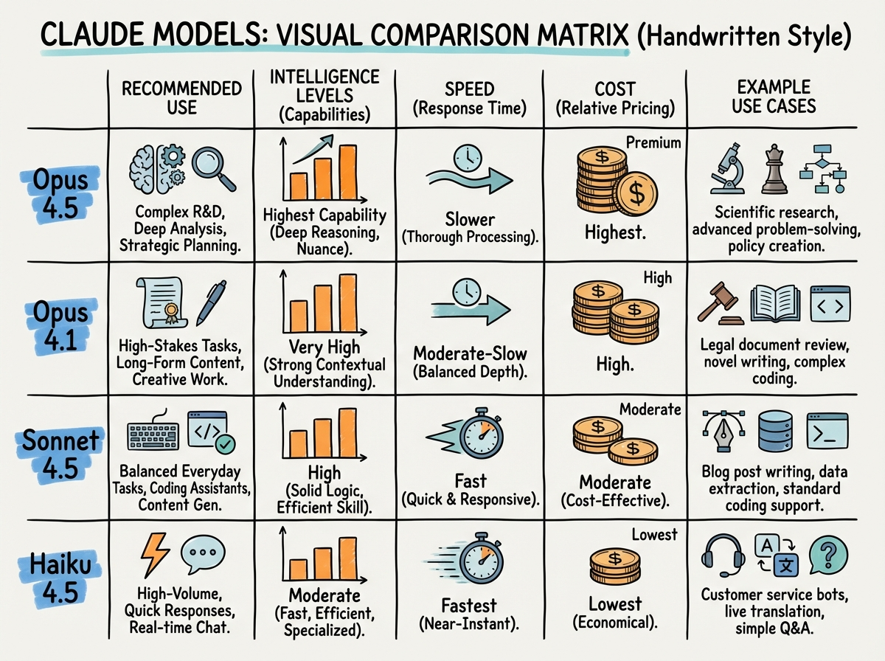
Claude Model Selection Matrix
Infographic for Claude Model Selection Matrix

Slide 10
Claude Model Selection Matrix
✓ Use Claude Sonnet 4.5 for complex agents, coding.
★ Select Sonnet 4.5 for superior tool orchestration.
◆ Choose Claude Opus 4.5 for maximum intelligence.
➜ Apply Opus 4.5 to complex, specialized tasks.
Notes:
This matrix helps identify which Claude model best suits specific needs. Sonnet 4.5 excels in complex agent tasks and coding, while Opus 4.5 offers maximum intelligence for highly specialized applications.

Slide 11
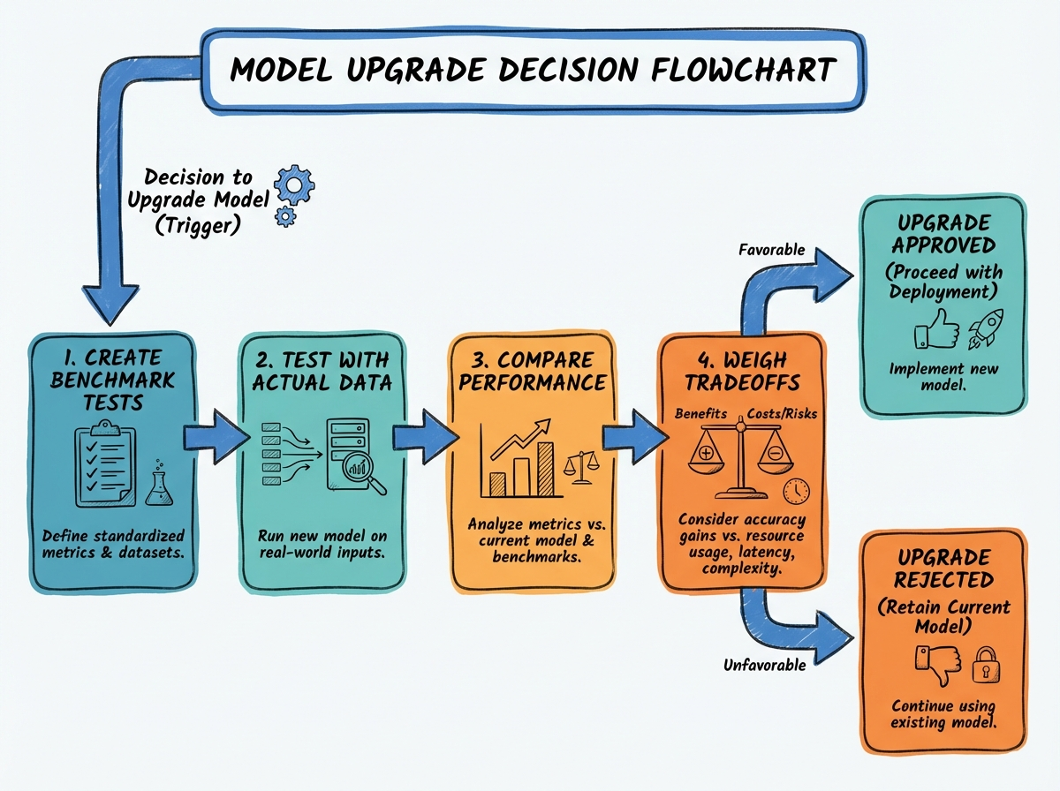
Decide on Model Upgrades
Infographic for Decide on Model Upgrades

Slide 12
Decide on Model Upgrades
✓ Develop specific benchmark tests for your application.
★ Conduct testing using actual prompts and real-world data.
◆ Compare model performance across accuracy and quality.
➜ Evaluate handling of edge cases for robust decisions.
Notes:
Deciding to upgrade models requires a systematic approach. Establish robust benchmark tests with actual data to objectively compare model performance. This ensures any transition is justified by tangible improvements.

Slide 13
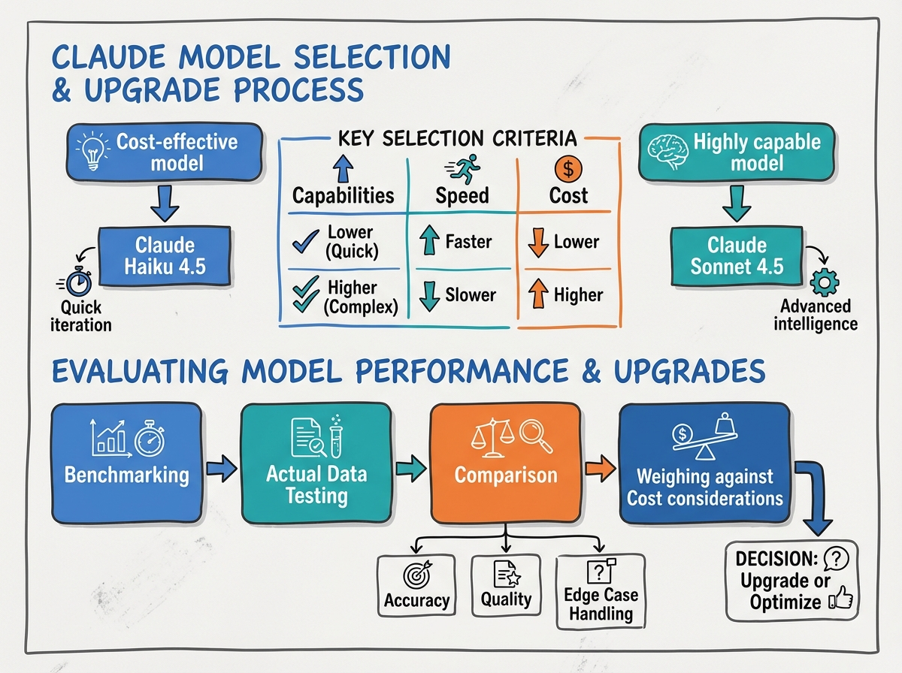
Key Takeaways
Infographic for Key Takeaways

Slide 14
Key Takeaways
✓ Balance model capabilities, speed, and cost factors.
★ Start with cost-effective (Haiku) or highly capable (Sonnet).
◆ Conduct rigorous benchmarking with actual data.
➜ Compare accuracy, quality, edge cases, and total cost.
Notes:
In summary, model selection is a strategic decision balancing core criteria. Choose an initial approach, then rigorously evaluate upgrades through benchmarking and real-world data to optimize performance and efficiency.

